Slide 1


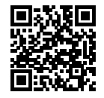

註冊請掃描QR code
Meeting: NutriTalks
Time: 15:00~23:30, April 16-17, 2021
Topics:
1.Nutritional support in ICU relating to COVID-19
2.Impact of nutrition support in ERAS
3. Nutritional Supplements as key success factors
4. Nutritional support in Oncology
5. Safe preparation of parenteral nutrition in the Pharmacy
完整資訊詳見:國內學術活動

